Slide 1
Python Lambda Functions

Slide 2
Python lambda (Anonymous Functions)
In Python, anonymous function means that a function is without a name.
This function can have any number of arguments but only one expression, which is evaluated and returned.
Lambda functions are syntactically restricted to a single expression.
Syntax:
lambda <arguments> : <expression>

Slide 3
Lambda Functions Syntax
lambda arguments : expression
x = lambda a:a**2
print(“square = ”,x(4))
-----------------------------------------------
x = lambda a,b:a*b
print("The total mul = ",x(4,5))

Slide 4
Difference…
def volume(l):
return l**3
print(volume(5))
g = lambda x,y: x+y**3
print(g(5,6))

Slide 5
Example…
def table(n):
return lambd a:a*n;
n = int(input("Enter the number?"))
table = table(n)
for i in range(1,11):
print(n,"X",i,"=",table(i));

Slide 6
Filtering
The function filter(function, list) offers an elegant way to filter out all the elements of a list, for which the function function returns True.
The function filter(f,l) needs a function f as its first argument. f returns a Boolean value, i.e. either True or False.
This function will be applied to every element of the list l. Only if f returns True will the element of the list be included in the result list.
filter(<boolean_condition>,list)

Slide 7
Filtering Example
#program to filter out the list which is divisible by 3
Lists = [1,2,3,4,10,123,22]
div = list(filter(lambda x:(x%3 == 0),Lists))
even = list(filter(lambda x:(x%2 == 0),Lists))
print(div)
print(even)

Slide 8
Map function
The map() function in Python takes in a function and a list as argument.
The function map(s,l) needs a function f as its first argument. s returns sequence value.
Syntax:
map(<lambda_function>,list)

Slide 9
Map function
List = [1,2,3,4,10,123,22]
new_list = list(map(lambda x:x**3,List))
print(new_list)
Lists = [1,2,3,4,5,6,7,8,9,10]
mul = list(map(lambda x:x*5,Lists))
print(mul)

Slide 10
Reduce() function
The reduce() function in Python takes in a function and a list as argument.
The function is called with a lambda function and a list and a new reduced result is returned.
This performs a repetitive operation over the pairs of the list.
reduce(<operation Function>,list)

Slide 11
Example…
from functools import reduce
lists = [5,5,6,9,3,4,8,8,3]
sum = reduce((lambda x, y: x + y), lists)
print (sum)
------------------------------------------------------
fun = lambda x,y: x if (x > y) else y
reduce(fun, [12,43,32,67,98,23,34])

Slide 12
Recursive Function

Slide 13
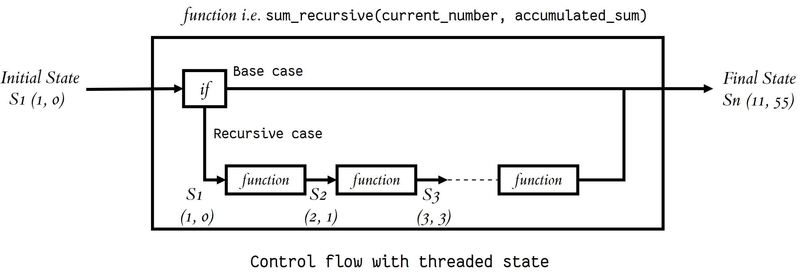
Recursive Functions in Python
Recursion is the process of defining something in terms of itself.
a function calls itself one or more times in its body

Slide 14
Recursive Functions in Python
def factorial(n):
if n == 1:
return 1
else:
return n * factorial(n-1)
print(factorial(5))

Slide 15
Recursive Functions in Python
def fib(n):
if n == 0:
return 0
elif n == 1:
return 1
else:
return fib(n-1) + fib(n-2)
fib(10)

Slide 16
Recursive Functions in Python
def sum_n(n):
if n== 0:
return 0
else:
return n + sum_n(n-1)
sum_n(5)

